Slide 1
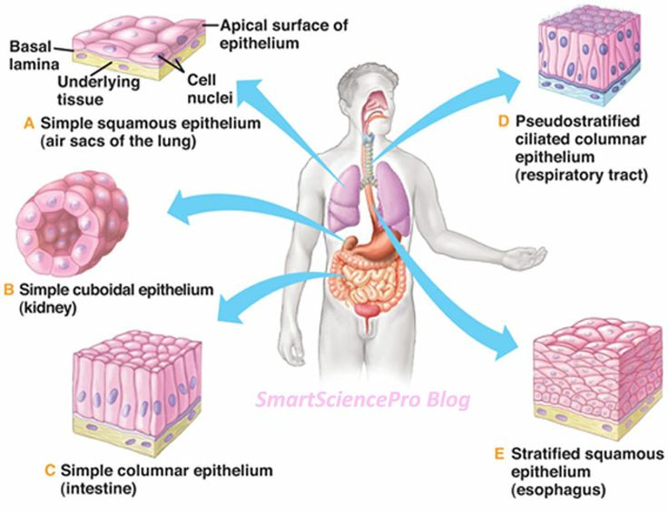
General histology
Dr. Ahmed Saadi

Slide 4
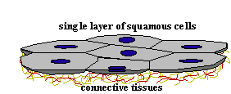
Simple squamous epithelium

Slide 18
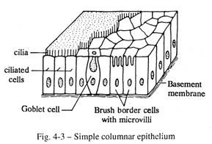
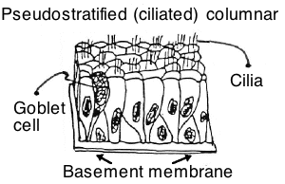

Slide 19
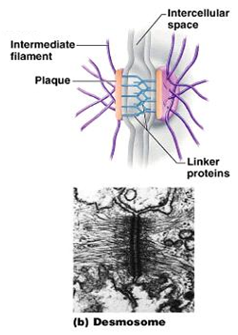

Slide 20
Transitional Epithelium

Slide 21
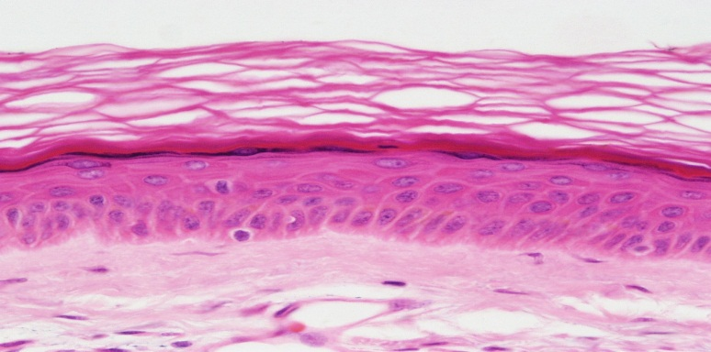
Stratified Squamous Epithelium

Slide 22
Pseudostratified Columnar Epithelium

Slide 23
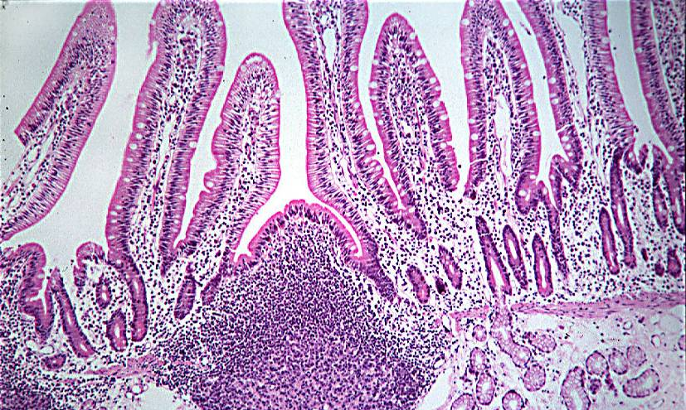
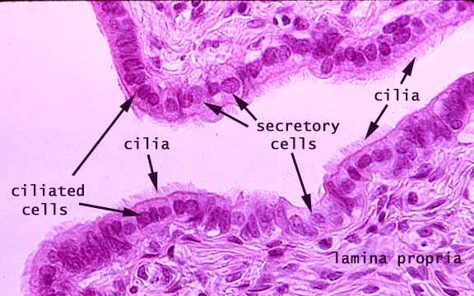
Simple Columnar Epithelium

Slide 24
Simple Cuboidal Epithelium

Slide 25
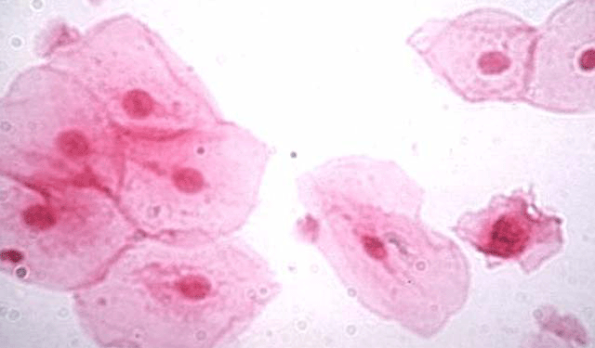
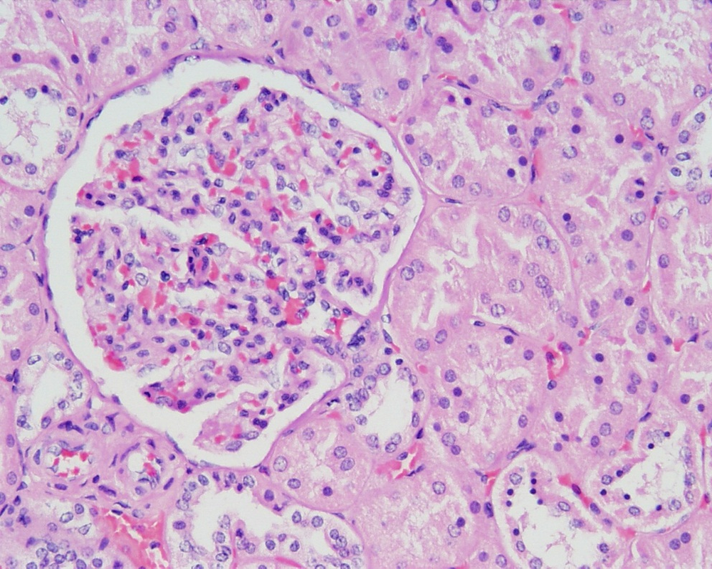
Simple Squamous Epithelium
Simple squamous lining the walls of the capillary

Slide 26
Thank You

